Slide 1
CHATBOT DEPLOYMENT WITH IBM CLOUD WATTSON ASSISTANT
TEAM LEADER –DHANALAKSHMI C-731221205006
TEAM MEMBERS
AHALYA.JC-731221205301
MANILA.K-731221205020
MAHADEVAMMA.S-731221205017
RATHNA.R-731221205033

Slide 2
STEPS
Gain a basic understanding of Watson Assistant.
Understand the development steps.
Apply Enterprise Design Thinking for a cognitive solution.
Create an instance of Watson Assistant and a workspace.
Define intent and entities to help natural language processing.
Build a simple dialog flow.
Use the context object for more advanced dialog.
Develop a hierarchical flow.
Use variables to get data from Watson Assistant.
Use the API.

Slide 3
TASK
Task 1: Create the Watson Assistant service
Task 2: Create a workspace
Task 3: Test the intents
Task 4: Add entities
Task 5: Build the dialog
Task 6: Complete advanced dialog work
Task 7: Use the API

Slide 4
Task 1: Create the Watson Assistant service
The first task is to create an instance of Watson Assistant, which is the service that allows the creation of your Watson Assistant, on IBM Cloud. Along with your Watson Assistant instance, you create your first assistant and skill.

Slide 5
An assistant helps your customers complete tasks and get information faster. It can clarify requests, search for answers from a knowledge base, and direct your customer to a human if needed. An assistant can hold a dialog skill, a search skill, or both. Think of an assistant as the end product.
Skills contain the training to respond to your customer queries. Add skills to your assistant and then deploy to your channels. A skill can be one of two types: dialog or search. For your assistant, you create and use a dialog skill only. Think of a skill as the means to an end.

Slide 6
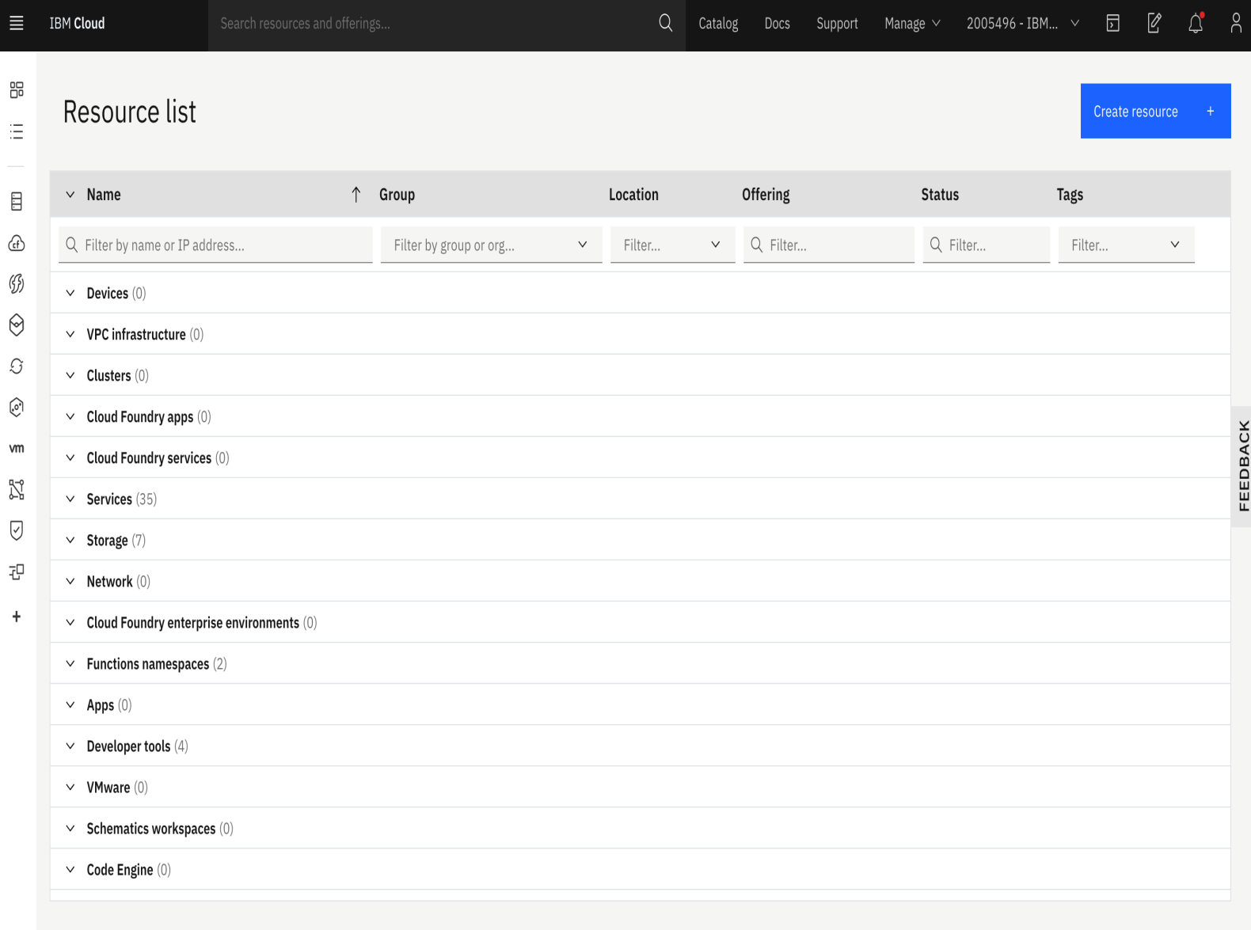

Slide 7
Task 2: Create a workspace
To identify intents, start with something that a user might want and then list the ways that the user might describe it. For each intent, think of the various ways that users might express their desires—those are the examples. You can develop examples by using a crowdsourcing approach. For instance, in a discussion with the support team, you might gather this set of standard questions that support received from users:
What is the status of the business application? I can't access it.
How do I get access to a business application?
How do I reset my password for a specific application?

Slide 8
When should I renew my workstation?
How do I bring my own device and connect it to an enterprise network?
Each of those questions is documented as a frequently asked question in the support team's document repository. Some solutions persist in a relational database in the form of application > problem > solution.
Based on the questions, you can extract these intents:
Access to a business application such as an expense report
Reset password
Access to supplier onboarding business process
Bring your own device

Slide 9
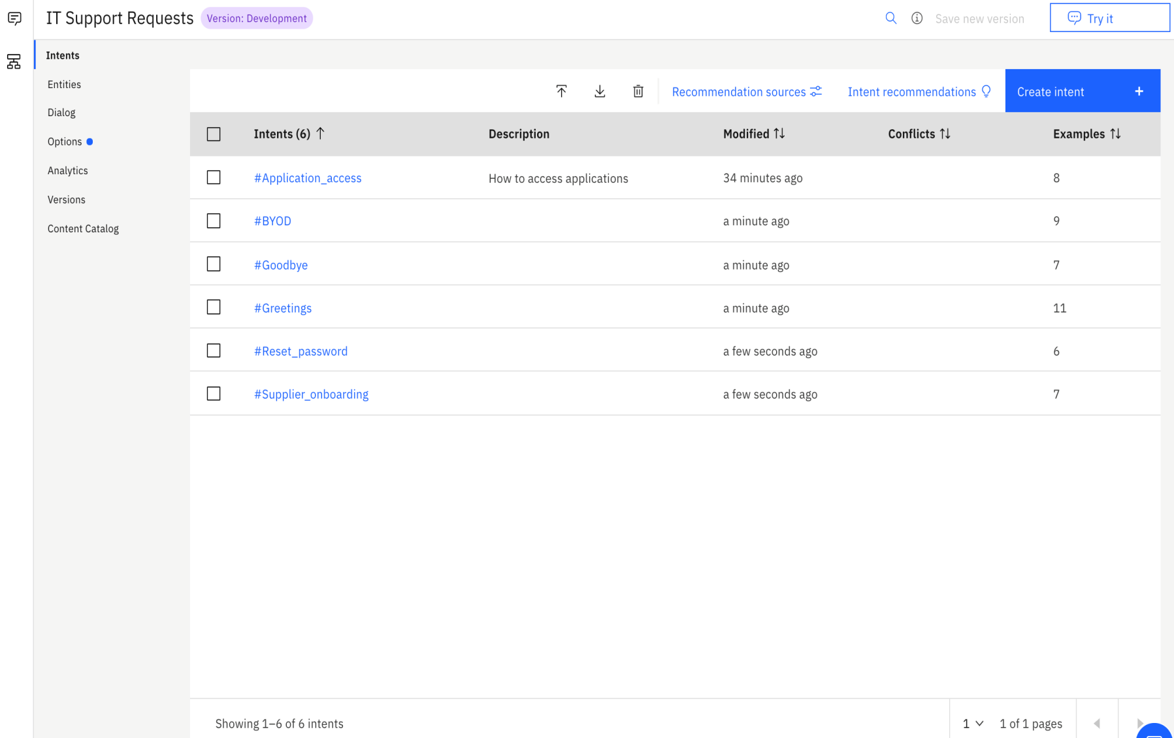
Task 3: Test the intents

Slide 10
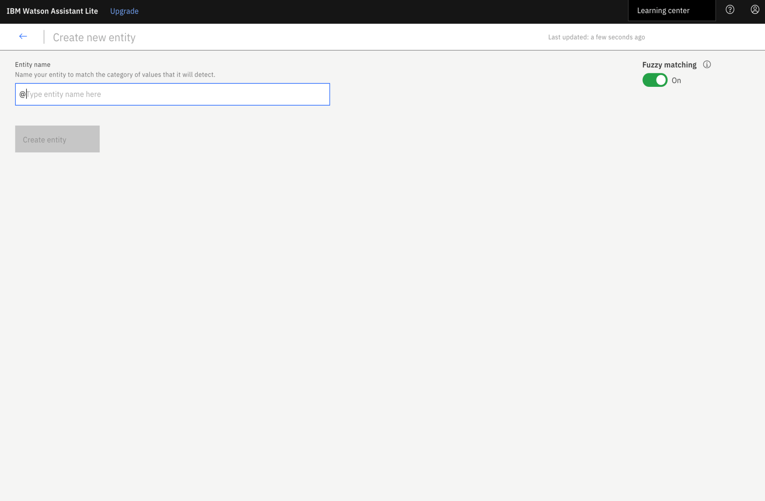
Task 4: Add entities

Slide 11
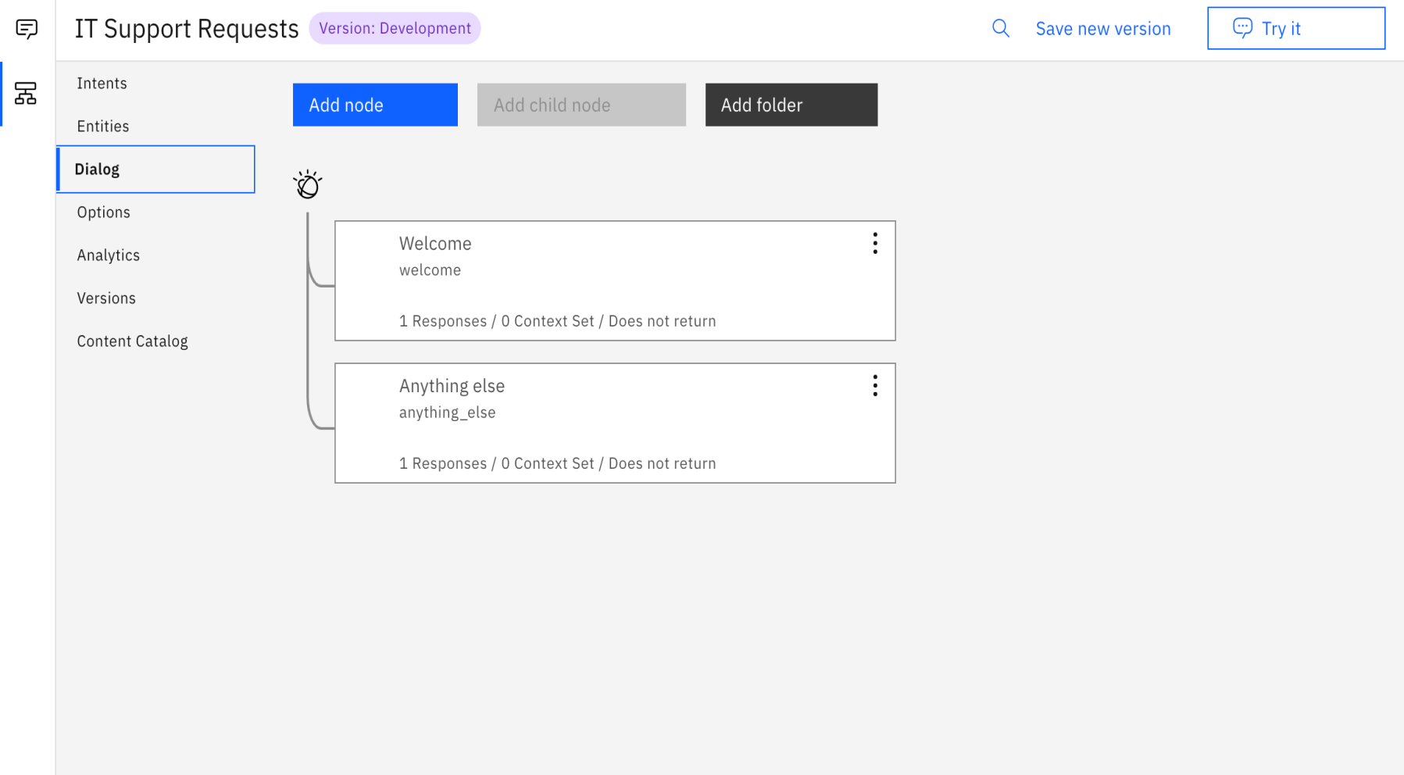
Task 5: Build the dialog

Slide 12
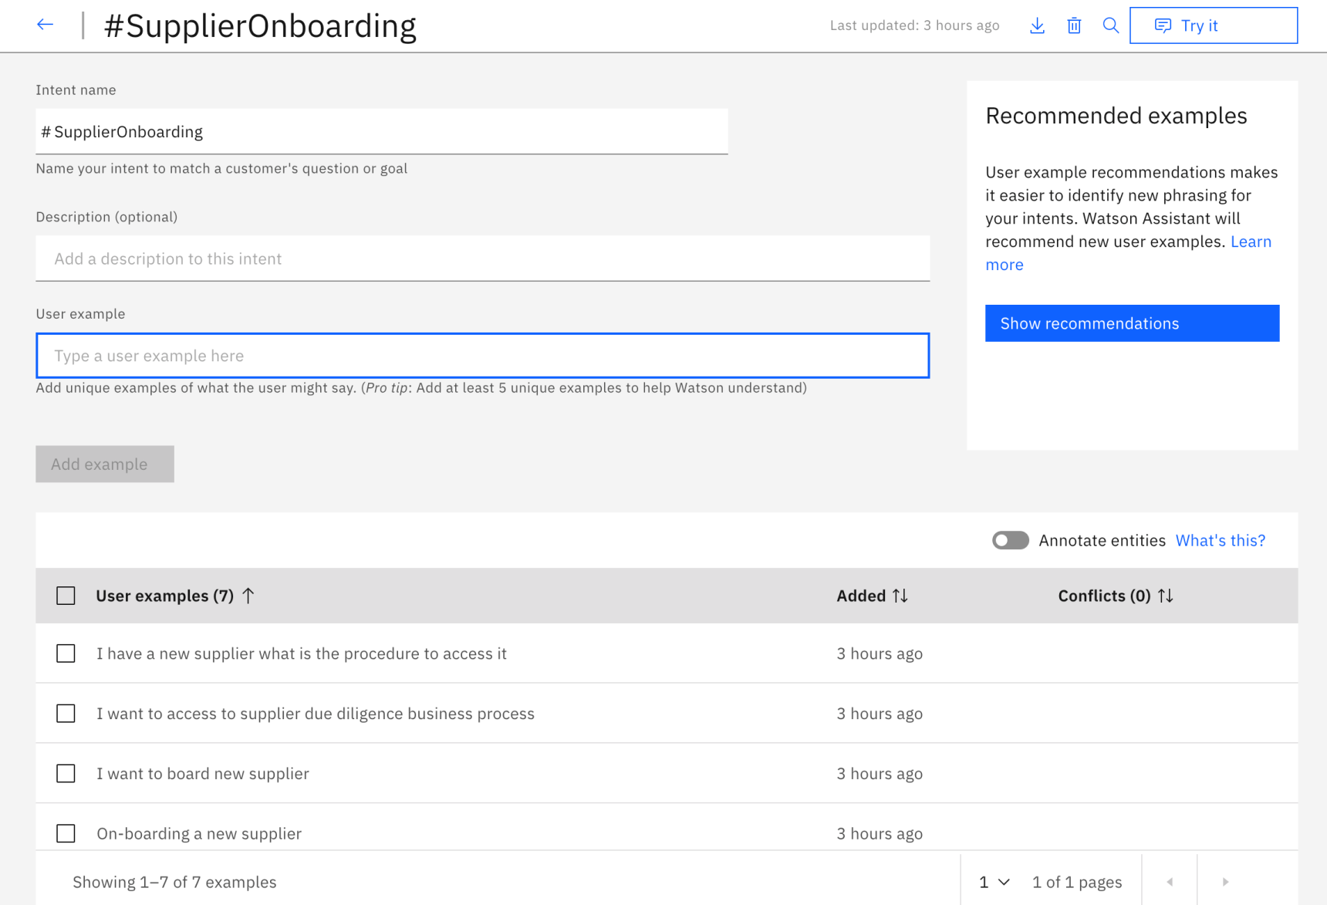
Task 6: Complete advanced dialog work

Slide 13
Task 7: Use the API
To use the API, you need the service credentials and the tool to complete an HTTP request. For instructions, see Use Watson Assistant API.

Slide 14
const express = require('express');
const app = express();
var config = require('./config/config.json');
require('./routes/api')(app,config)
/ Catch all other routes and return the index file
app.get('*', (req, res) => {
res.sendFile(path.join(__dirname, '../dist/index.html'));
});
// get the app environment from Cloud Foundry
var appEnv = cfenv.getAppEnv();
/**
* Get port from environment or local config parameters.
*/
const port = process.env.PORT || config.port;
..

Slide 15
THANK YOU…

